Slide 1
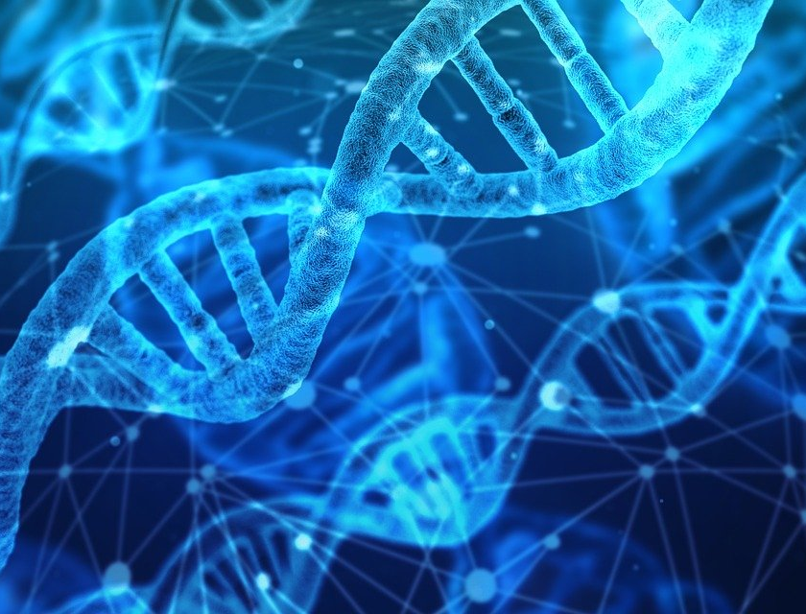
Topic2
membranes,proteins,dna and gene expression
Kristin Guan

Slide 2
01
02
03
知识梳理：细胞膜，物质运输，气体交换，酶
DNA/RNA，基因编码，遗传学
做题咯～

Slide 3
01
细胞膜构造，物质运输，气体交换，酶

Slide 4
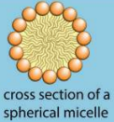
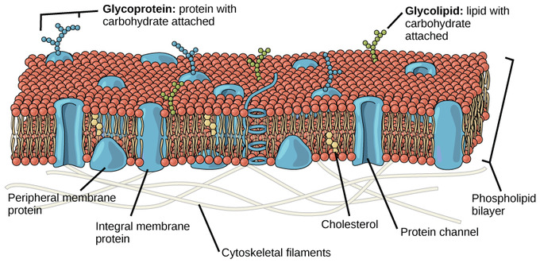
Cell membranes
Fluid mosaic model:
fluid ：individual phospholipid and protein molecules move around within their monolayer.
mosaic ：describes the pattern produced by scattered protein molecules when the surface of the membrane is viewed from above.
2. phospholipid: ➡︎hydrophobic tails：2 fatty acid chains
➡︎hydrophilic heads: phosphate
group and glycerol
3. phospholipid bilayer: basic structure of membrane
特点：partially permeable, 有极性的分子无法通过（可溶于水的物质也不行）
4. micelle
Fluidity的影响因素：
1.more unsturated, more fluid（越不饱和，流动性越强）because unsaturated tails are bent ，fit together more loosely(不饱和的脂肪酸链被弯曲，结合越松散，流动性增强）
2.longer the tails, less fluid(tails越长，越容易缠在一起，流动性降低）
3.cholesterol 会降低 fluidity： 会和磷脂分子结合，阻碍热运动，降低通透性）
4.temperature：温度越高，得到动能，分子运动速率越快，流动性越强

Slide 5
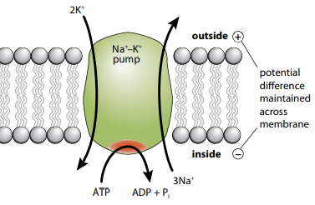
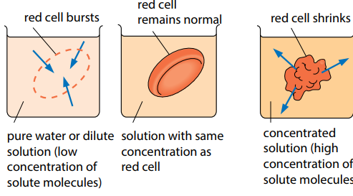
transport
1. passive transport 包含：diffusion和facilitate diffusion
Diff usion特点: from a region of high concentration to a region of
low concentration, down the concentration gradient
Facilitated diff usion: 1. down the concentration gradient
2. Molecules go through
channel proteins or carrier proteins
This allows for the passage of
large polar ions and molecules e.g.
glucose, amino acids, Na+
*no ATP energy required for any passive transport
2.active transport: channel proteins(carrier proteins),
against concentration gradient, use ATP energy
3.cytosis: * exocytosis：物质运输从内到外，借助vesicles
* endocytosis：物质运输从外到内，借助vesicles
4.osmosis（special case of diffusion ,针对水分子）
运输from high water potential to low water potential

Slide 6
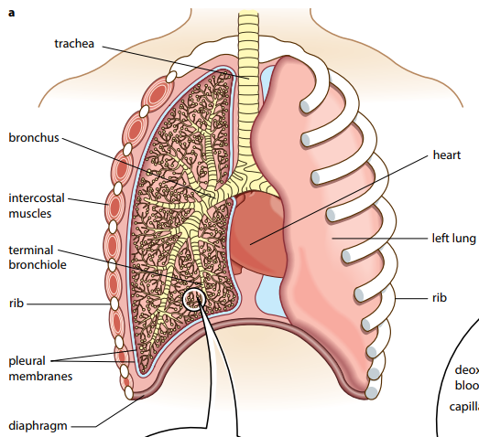
Gas exchange system
顺序：trachea，bronchi，bronchioles，alveoli
efficient gas exchange:1.large surface area：A large number of alveoli is present
to increase the surface area 2. thin surface：to decrease the diffusion distance,
毛细血管的walls也thin 3.steep concentration gradient ：Deoxygenated blood is brought
to the alveoli 4.ventilation 通气量：maintain diffusion gradient
Eepithelium：杯状细胞分泌粘液（mucus）catch pathogen 和微粒
纤毛细胞将粘液带出气道，通向喉
cartilage（c形骨）：打开通气道（airways），减少空气阻力，prevents
from collapsing and bursting（防止trachea 和bronchi 坍塌和爆裂，当air
pressure changes）
bronchiole：有smooth muscle，去relax 和 contract，
调整通气道的直径，舒张让更多空气通向肺泡。

Slide 7
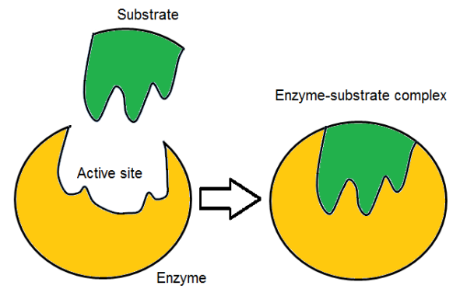
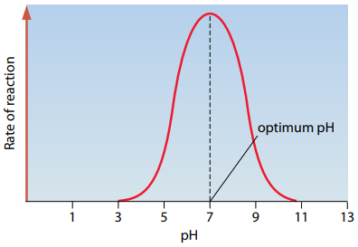
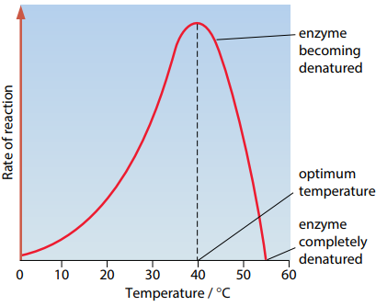
Enzyme(本质上是蛋白质）
1.biological catalyst：accelerate metabolic reactions.
2.globular proteins： spherical shape and water-soluble
3.active sites: specific that are complementary to the shape of substrate
active site 和 substrate 之间由氢键和离子键连接，形成enzyme-substrate complex
4.enzymes lower the activation energy
5.induced fit theory：enzymes are flexible and can slightly change shape as substrate enters
active site
蛋白质活性的影响因素：1.temperature：温度越高，动能和酶活性增加，酶和底物
之间的碰撞更加频繁，底物和酶的结合更加快和多，rate增加。但是当温度大过于optimum
temperature，rate会decrease，因为动能过多导致酶（蛋白质）的二级，三级结构的化学键
断裂，酶和活性位点的形状发生改变，底物不能和酶进行结合了，蛋白质失活。
2. PH
3.enzyme cocentration: 一开始，浓度越高，enzyme数量越多，有更多的活性位点可以和底物相结合，更多产物，
rate增加。时间久了后，有限数量的底物已经都和enzyme结合了，酶的数量增加已经对速率没有影响了，此时
限制因素是底物的浓度
4.substrate concentration：浓度越高，更高的几率和酶碰撞形成enzyme-substrate complex。时间久后，有限数量的酶
都和底物进行了结合，此时底物浓度的增加已经对速率没有影响了，限制因素转为enzyme concentration。

Slide 8
02
DNA&RNA
基因编码，遗传

Slide 9
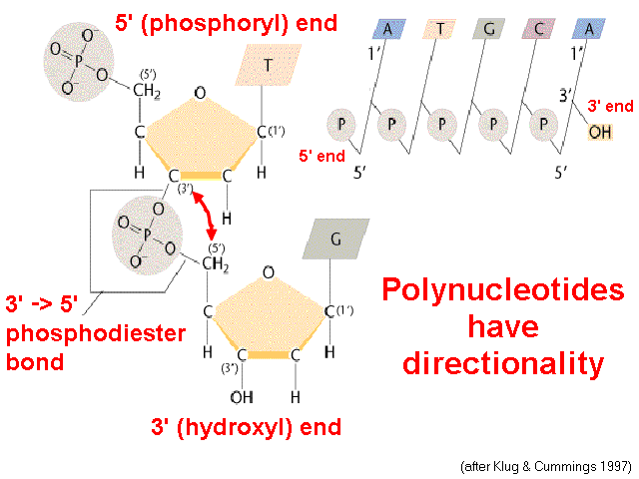
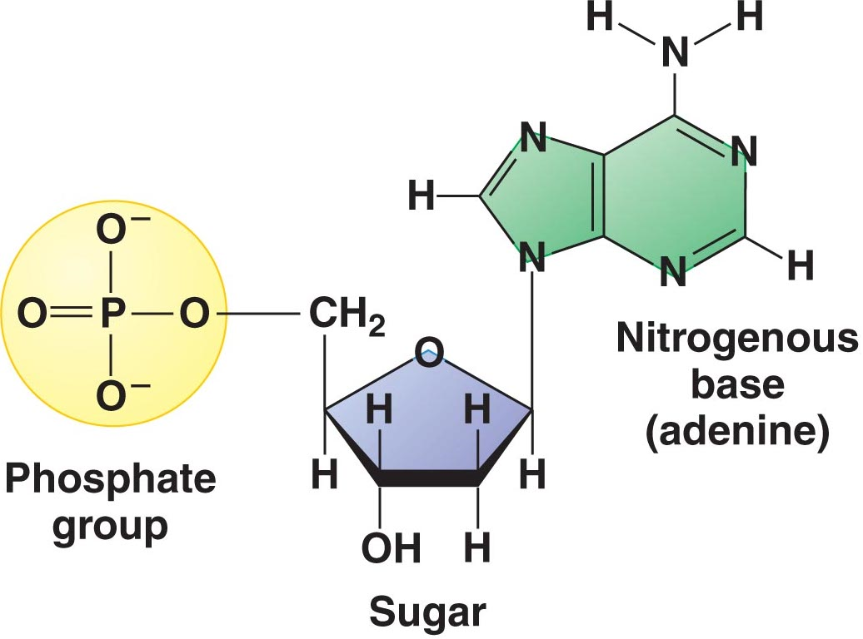
DNA&RNA
1.NUCLEIC ACIDS：double-strand,deoxyribose, bases: Adenine, thymine, guanine, and cytosine
其中，A和T之间有2个氢键，C和G 之间有3个氢键
2，backbone 之间的化学键是phosphodiesterbond / bases之间的化学键是hydrogen bond
3.DNA：double helix,double strands, deoxyribose, AGCT RNA:single strand ,oxyribose,AUCG
4.semi-conservative replication：The DNA separates into two strands, and each strand acts as a template.
Each new DNA molecule consists of one old strand and a complementary new strand.
(要熟悉证明半保留复制的实验，用氮15同位素和氮14同位素培养后代），正确描述实验步骤和实验现象
5。

Slide 10
DNA 复制
The DNA double helix unwinds and ‘unzips’ as the hydrogen bonds between the bases break by DNA helicase
the free nucleotides that pair up by complementary base pairing on each of the old DNA
DNA polymerase links adjacent nucleotides to each other by catalysing phosphodiester bonds.
DNA ligase links the okazaki fragments together
Hydrogen bonds form within the structure, allowing it to coil up into a double helix

Slide 11
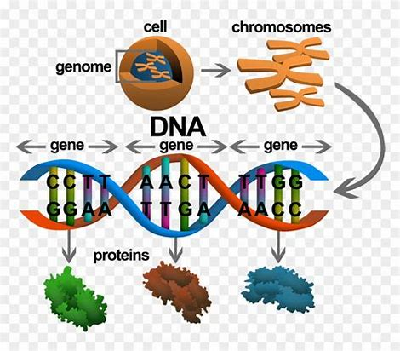
genetic code
一个染色体上只有一个gene，其中gene里面是有用的dna，可以形成有用的protein，一条dna上有很多基因
Gene: a length of DNA that codes for a particular polypeptide or protein
Codon密码子（1 codon=3bases）: A sequence of 3 bases in DNA or mRNA（还有anticodon）.
one gene
thousands more bases in gene (not shown)
It is a three-letter code, known as a triplet code：three bases make the code for one amino acid.
• The code is universal通用性:in all living things.
• The code has punctuations.
stop triplets（终止密码）: UAG,UAA,UGA. start codon：AUG起始密码子
• The code is degenerate简并性（多个droplet）or degeneracy.
some amino acids are coded for by more than one triplet:cysteine is coded for by ACA and ACG.
Commaless连续性：after one amino acid is coded, the second amino acid will be automatically, coded by the next three letters
The genetic code is non-overlapping不重叠: each base is only part of one triplet/codon, and each triplet/codon codes just one amino acid.

Slide 12
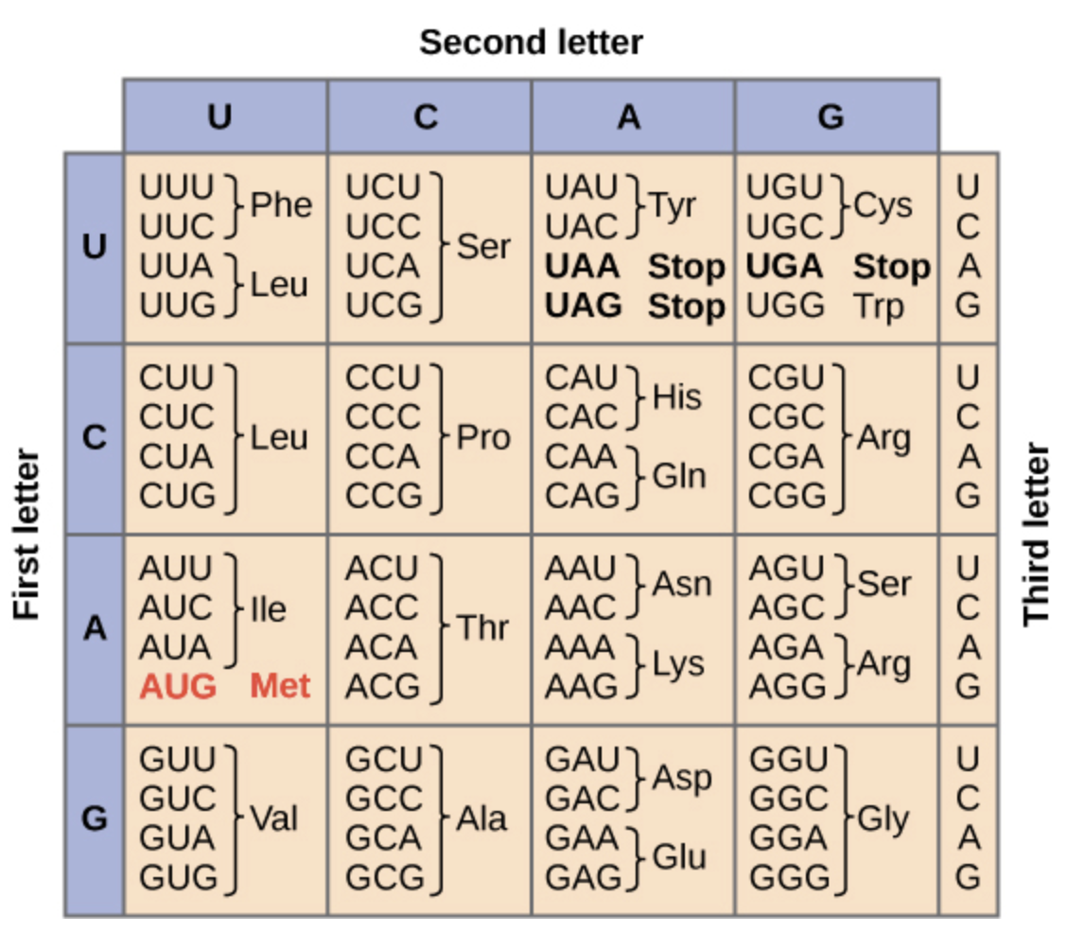

Slide 13
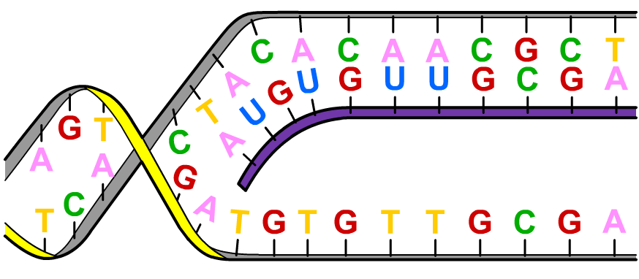
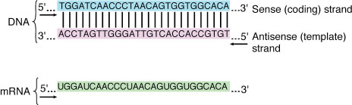
mRNA
Transcription（发生在细胞核）: copying the genetic information in a molecule of DNA into a complementary strand of mRNA; a single strand of the DNA is used as a template（一条链可以作为模版进行互补）
mRNA strand during transcription
after transcription ,mRNA will leave the nucleus into the cytoplasm
Like DNA, mRNA is a nucleic acid, but it differs in that:
it is single stranded
it contains ribose instead of deoxyribose
it contains uracil instead of thymine.

Slide 14
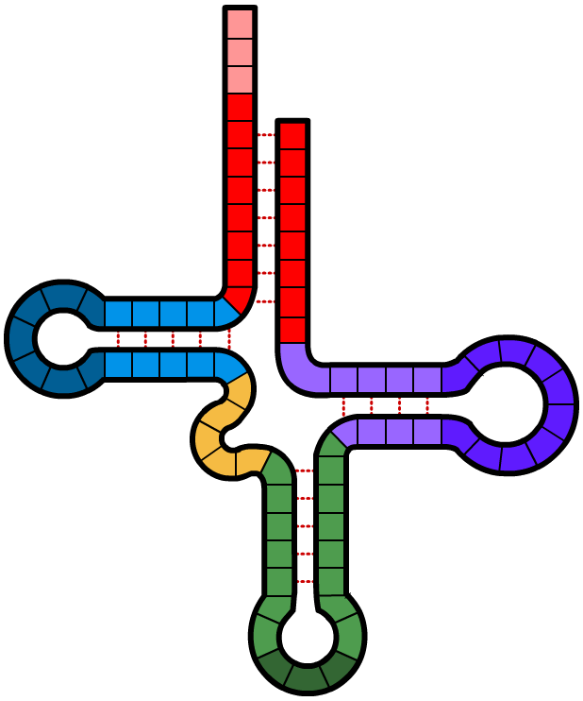
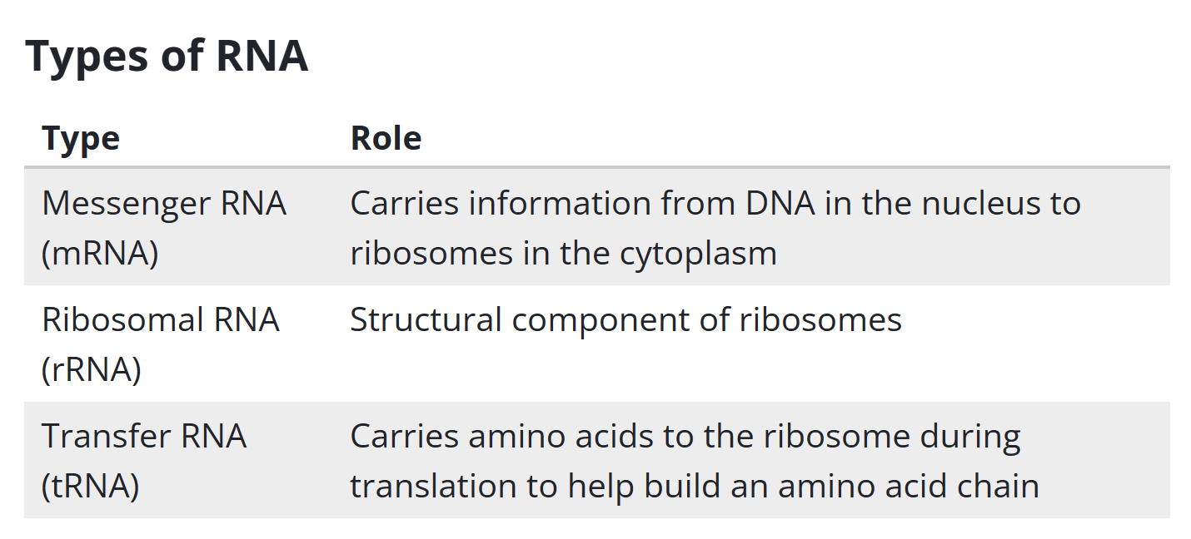
tRNA
In the cytoplasm, amino acids attach to transfer RNA (tRNA) molecules. Each tRNA is specific for one amino acid.
amino acid
attachment site
CCA
Each tRNA molecule has a sequence of three bases called an anticodon. These are complementary to codons on the mRNA molecule，
3’ end
hydrogen bond
nucleotides
anticodon

Slide 15
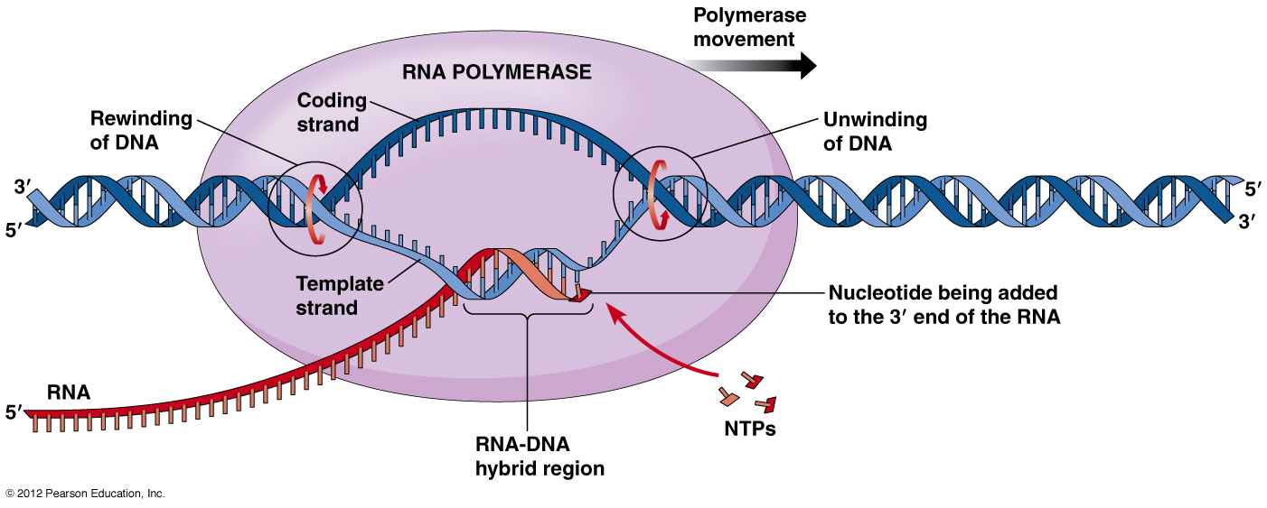
Transcription
Process by which enzymes use the antisense strand of DNA as a template to produce a messenger RNA (mRNA) molecule.
1) RNA polymerase（先断开氢键，再继续复制） binds to a region of gene to be copied
this signals DNA to unwind so bases can be read
the strand that’s read is the template/antisense strand
Notes:
聚合酶（polymerase）又称多聚酶。是专门生物催化合成脱氧核糖核酸(DNA)和核糖核酸(RNA)的一类酶的统称。1957年，美国科学家阿瑟·科恩伯格（Arthur Kornberg）发现。
(1)依赖DNA的DNA聚合酶；(2)依赖RNA的DNA聚合酶；(3)依赖DNA的RNA聚合酶；(4)依赖RNA的RNA聚合酶。前两者是DNA聚合酶，它使DNA复制链按模板顺序延长。(3)和(4)是催化RNA生物合成反应中最主要的RNA合成酶，它们以四种三磷酸核糖核苷(NTP)为底物，并需有DNA模板以及Mn2 及Mg2 的存在下，在前一个核苷酸3′-OH与下一个核苷酸的5′-P聚合形成3′，5′-磷酸二酯键，其新生链的方向也是5′→3′
RNA聚合酶催化RNA的合成，其与DNA聚合酶有许多相同的催化特点：
①以DNA为模板；
②催化核苷酸通过聚合反应合成核酸；
③聚合反应是核苷酸形成3’，5’一磷酸二酯键的反应；
④以3’→5’方向阅读模板，5’→3’方向合成核酸；
⑤按照碱基配对原则忠实转录模板序列
与DNA聚合酶不同，RNA聚合酶无须引物，它能直接在模板上合成RNA链；RNA聚合酶能够局部解开DNA的两条链，所以转录时无须将DNA双链完全解开，RNA聚合酶无校对功能

Slide 16
2) RNA polymerase reads antisense strand and generates mRNA from
5’ to 3’，phosphodiester bonds，hydrogen bonds
3) when RNA polymerase has reached the terminator sequence at the end of the gene, transcription stops，mRNA is released
- enzyme detaches from gene and DNA returns to original structure
4) STOP Code：in DNA the stop codons are UAA, UGA, UAG
5）Once a molecule of mRNA has been transcribed, it moves out of the nucleus via a nuclear pore
Notes:
5）转录完成，离开细胞核

Slide 17
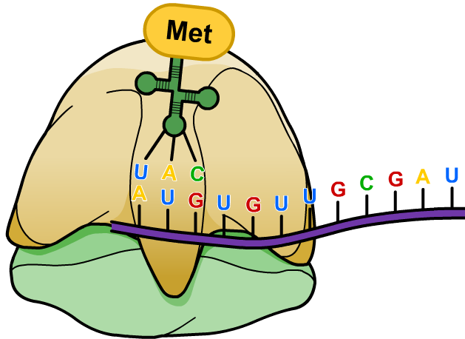
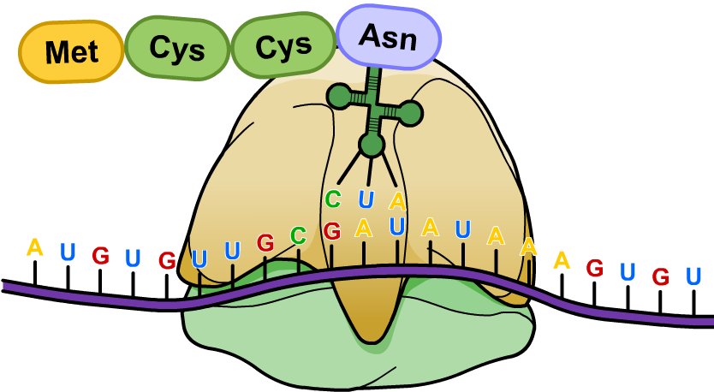
Translation:1,发生场所：cytoplasm
Process by which the genetic code in mRNA is read to make a protein.
1) every 3 bases (a codon) on mRNA codes for a specific anticodon which is carried by a transfer RNA (tRNA) molecule
2） each different tRNA is linked to a particular amino acid
process：
1）mRNA leaves the nucleus and binds to the ribosome
2) an initiator tRNA carriers amino acid to adheres to a START codon：AUG
3) the next tRNA enters the ribosome carrying an amino acid with it which becomes covalently bound to methionine from the initiator tRNA
4）moving of ribosome，a new amino acid carried by new tRNA links the first two，first tRNA detaches
5） this polypeptide chain continues to grow till a STOP codon is reached

Slide 18
Genetic mutations
A mutation is a change in the amount or structure of DNA. There are two types of mutation:
A gene or point mutation – a change in the base sequence of a gene, which can cause a change in the polypeptide chain. It is caused by errors that occur during DNA replication.
A chromosome mutation – a change in the number or structure of the chromosomes. It is caused by errors that occur during cell division.

Slide 19
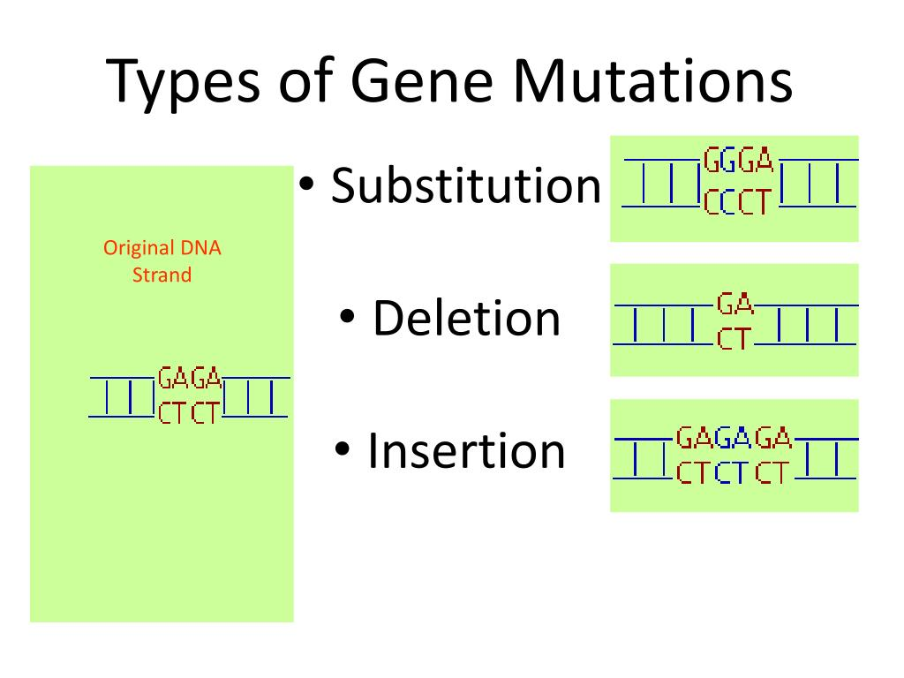
substitution： one base in a gene is substituted for another
deletion： a base is completely lost
insertion： an extra base is added into a gene, which may be a repeat or a different base

Slide 20
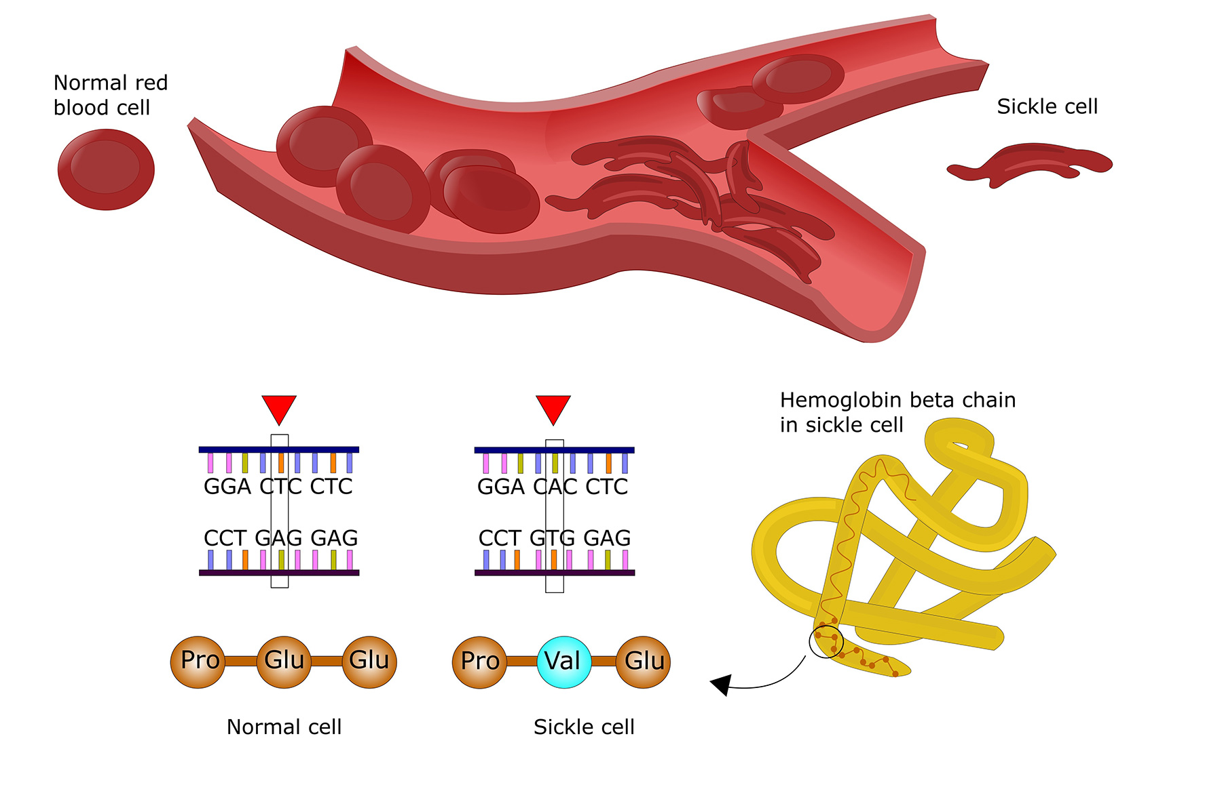
sickle cell anemia镰刀形贫血症（隐性疾病）
mutation is called substitution
疟疾
表面积减少，氧含量减少，感到疲惫

Slide 21
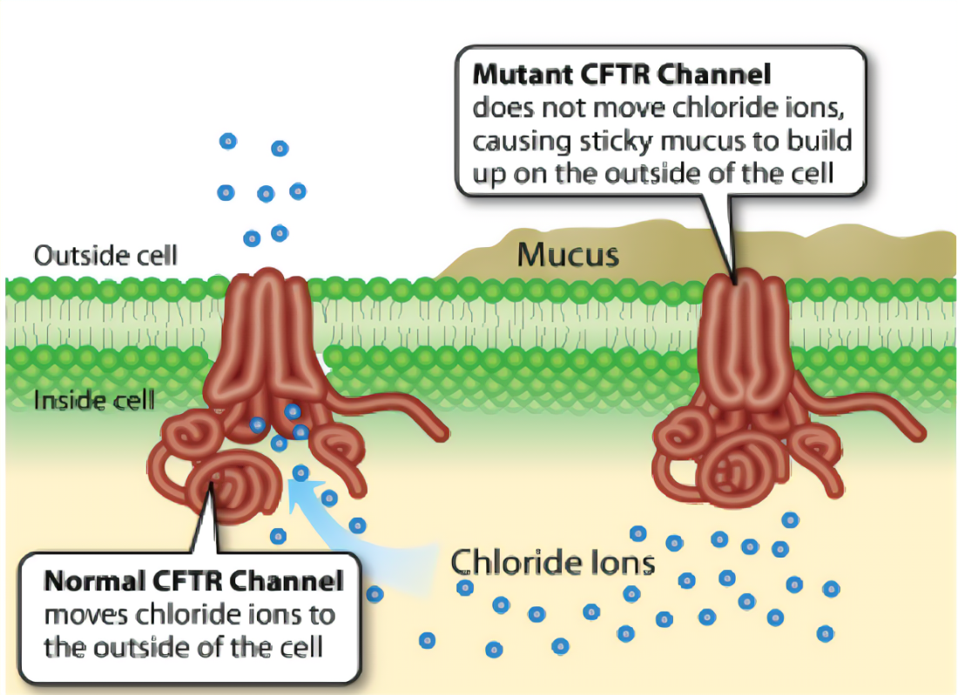
Cystic fibrosis囊性纤维化
Cystic fibrosis (CF) is a recessive inherited disease隐性遗传病. It is caused by a number of different point mutations in the CFTR （氯离子通道）gene, which codes for a transmembrane protein that acts as an Cl- pump.
normally，In the lung,the CFTR ion channel moves chloride ions from inside the cell to outside the cell.
With CFTR mutations, excessive Cl- accumulate inside the cell, causing more water to return from the outside and mucus to be more thick and sticky

Slide 22
Effects on respiratory system
unable to move as the mucus is so thick and sticky
frequent infections
block airways which limits gas exchange粘液粘在气道壁上，narrow airways
The surface area for gas exchange is reduced which can cause breathing difficulties
lack in energy
reduced immunity

Slide 23
Effects on the digestive system
Thick mucus in the digestive system
Blockage of the pancreatic duct reduces digestion of nutrients
The villi of the small intestine are covered to reduce absorption
malnutrition
Islets胰岛 may be destroyed by enzymes, leading to disease-diabetes
产生脂肪酶，淀粉酶，消化酶，蛋白酶，胰岛素分泌，
通过胰腺管输出到小肠，被粘液堵住了，所以通不过去
Notes:
胰腺分为外分泌部和内分泌部两部分。外分泌腺由腺泡和腺管组成，腺泡分泌胰液，腺管是胰液排出的通道。胰液中含有碳酸氢钠、胰蛋白酶原、脂肪酶、淀粉酶等。胰液通过胰腺管排入十二指肠，有消化蛋白质、脂肪和糖的作用。
内分泌腺由大小不同的细胞团——胰岛所组成，胰岛主要由4种细胞组成：α细胞、β细胞、D细胞、PP细胞。
α细胞分泌胰高血糖素，升高血糖；
β细胞分泌胰岛素，降低血糖；
D细胞分泌生长抑素，以旁分泌的方式抑制A、B细胞的分泌；
PP细胞分泌胰多肽，抑制胃肠运动、胰液分泌和胆囊收缩。

Slide 24
Effects on the reproductive system
in men，seminiferous duct输精管 is blocked, preventing sperm from reaching the penis
In women thickened cervical宫颈 mucus can prevent sperm reaching the oviduct to fertilise an egg过于粘稠而堵住不让精子进入。

Slide 25
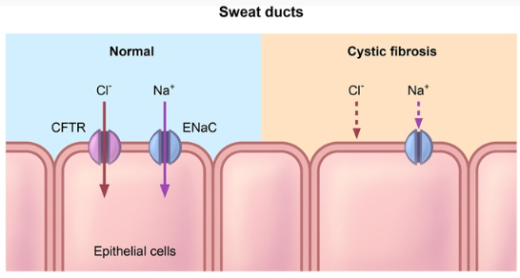
Effects on the sweat glands
In sweat glands, CFTR functions to reabsorb Na+，Cl-
Sweat is mainly composed of salt and water
Reabsorption of salt prevents the body from losing too much salt
Mutations in CFTR cause sodium and chloride ions remain in sweat
Saltier sweat更咸，氯离子堆积，汗水更咸
Notes:
Epithelial Sodium Channel

Slide 26
Prenatal testing
The DNA can be obtained by chorionic villus samplingCVS or amniocentesis in the uterus
Amniocentesis羊水穿刺 involves removing about 20cm3 of the amniotic fuid which surrounds the fetus using a needle and syringe.
This is done at about the 16th week of pregnancy.
Fetal epithelial cells and blood cells can be recovered from the fuid after spinning it in a centrifuge离心.
The cells are cultured培养 for 2---3 weeks and then a number of genetic defects and the sex can be determined .

Slide 27
Amniocentesis has the following disadvantages.
It can only be carried out relatively late in the pregnancy making it very difficult for the parents if termination of the pregnancy is necessary.
The results are not available until 2-3 weeks after the test.
It carries a 0.5- -1% risk of spontaneous abortion after the procedure, regardless of the genetic status of the fetus

Slide 28
In chorionic villus sampling, a small sample of embryonic tissue is taken from the developing placenta at 8-10th week.
Insert an instrument called a speculum窥镜 into your vagina
Using ultrasound guidance, a thin tube will be guided through the cervix to the chorionic villi.
3. Ultrasound will be used to help guide a long, thin, hollow needle through your abdomen and into the uterus and placenta.
4. Cells will be gently suctioned through the tube into a syringe.
5. The tube/needle will then be removed.
Notes:
There are two types of CVS procedures:
Transcervical. In this procedure, a catheter is inserted through the cervix into the placenta to obtain the tissue sample
Transabdominal. In this procedure, a needle is inserted through the abdomen and uterus into the placenta to obtain the tissue sample

Slide 29
benefits of CVS：
This makes a much bigger sample更多样本 of fetal tissue available for examination. 不用培养
The cells can be tested for a wide range of genetic abnormalities.
This diagnostic technique can be carried out much earlier in the pregnancy, so that if a termination is necessary it is physically less traumatic for the mother
The results are also available more rapidly than for amniocentesis.

Slide 30
There are two disadvantages to chorionic villus sampling.
● There is a 0.5- -1% risk that the embryo may spontaneously abort after the tissue sample is taken
● All paternal X chromosomes are inactivated in fetal placental cells so any problems in the genes on that chromosome cannot be detected by this technique.
Notes:
剂量补偿效应，英文名是 dosage compensation 。使细胞核中具有两份或两份以上基因的个体和只有一份基因的个体出现相同表型的遗传效应。一个细胞核中某一基因的数目称为基因剂量。在以性染色体决定性别的动物中，常染色体上的基因剂量并无差别，因为雌雄两性动物的常染色体的形态和数目都相同。但是对于性染色体来讲，包括人类在内的哺乳动物雌性个体的每一体细胞中有两条X染色体，所以在X染色体上的基因剂量有两份，而雄性个体只有一条 X染色体，基因剂量只有一份。
①正常雌性哺乳动物体细胞中的两个，X染色体之一在遗传性状表达上是失活的；
②在同一个体的不同细胞中，失活的X染色体可来源于雌性亲本，也可来源于雄性亲本；
③失活现象发生在胚胎发育的早期，一旦出现则从这一细胞分裂增殖而成的体细胞克隆中失活的都是同一来源的染色体。
人类女性的X染色体失活在胚胎发育的第16天就已发生，而且哪一条X染色体失活是随机的。其他有胎盘的哺乳动物也类同,但有袋类（如雌性袋鼠）失活的X染色体是有选择性的，失活的总是来源于雄性亲本的X染色体。
但很多疾病临床表型多变，X染色体失活只是有可能导致表型差异的其中一个因素。研究显示，人类中有15%的X-连锁基因会出现XCI逃逸，可能是因为它们编码的是一些高度剂量敏感的关键蛋白。逃逸基因的表达程度不同也可能会导致临床表型的差异。
Imprinted X Inactivation: Preferential Silencing of the Father
As mentioned earlier in the article, there are two types of X inactivation: imprinted and random. During imprinted X inactivation, the paternal (father's) X chromosome is preferentially silenced in the placenta (an extraembryonic tissue) of eutherian mammals, as well as in all cells of earlier marsupial mammals, such as opossums and kangaroos (Graves, 2006; Huynh & Lee, 2005). Interestingly, XIST and TSIX are both important for imprinted XCI in the mouse (a eutherian), but marsupials do not have an XIST gene homologue (Duret et al., 2006; Lee, 2000; Marahrens et al., 1997; Sado et al., 2001). This raises the question of how imprinted inactivation is achieved in marsupials without using XIST. One possible mechanism involves pre-silencing of the paternal X in the male germ line during a process whereby both sex chromosomes are inactivated during meiosis; here, the inactive state of the X could be transmitted to the next generation (Hornecker et al., 2007; Huynh & Lee, 2005; Namekawa et al., 2007). From an evolutionary point of view, such a form of inherited XCI would have easily and economically achieved dosage compensation in female embryos, because only females inherit an X chromosome from their fathers.
Interestingly, remnants of this type of mechanism may still exist in eutherian mammals, such as the mouse (Huynh & Lee, 2005). While debate remains concerning the details of how and when dosage compensation is achieved, it is clear that imprinted XCI first occurs in all cells of early eutherian mammalian embryos prior to implantation into the uterus (Huynh & Lee, 2005; Okamoto & Heard, 2006). Together with the fact that earlier mammals, such as marsupials, also only silence their paternal Xs, imprinted XCI may represent an evolutionarily ancestral form of X inactivation. Occurring before the appearance of XIST and TSIX, imprinted XCI led to the evolution of random XCI in eutherian mammals.
Random X Inactivation
Random X inactivation occurs in the early female embryo, where both the maternal and the paternal X chromosome have an equal chance of becoming inactivated (Figure 4). Each female cell has the difficult task of trying to distinguish between two X chromosomes within the same nucleus, then designating one as an active X chromosome and the other as an inactive X. This complex process of silencing is accomplished independently in each cell, largely by XIST and TSIX.
Embryonic stem (ES) cells can undergo random X inactivation when differentiated in vitro (Martin et al., 1978; Rastan & Robertson, 1985), and they thus serve as a good model system with which to study this phenomenon. In fact, the use of ES cells along with early mouse embryos has enabled geneticists to dissect the different phases of the random XCI pathway. It seems that each cell first counts its number of X chromosomes, then randomly chooses one X to remain active, and, finally, silences the future inactive X (Bourmil & Lee, 2001). Whole-chromosome silencing involves the recruitment of many specialized factors, such as histone variants and chromatin modifiers (Lucchesi et al., 2005).
In addition to silencing one of the two Xs, the cell must also make sure that the other X remains active. Thus, there must be a way for the two Xs to communicate with each other to designate mutually exclusive fates. Interestingly, recent evidence suggests that this communication is mediated by protein- and transcription-dependent pairing between the Xs during early development (Bacher et al., 2006; Xu et al., 2006, 2007). The random XCI story becomes even more complex with the discovery of various enhancers and modifiers that can alter or skew inactivation of one X chromosome over the other.

Slide 31
Ethical &Social Issuesof Genetic Screening
Belief that God is in control may mean that a pregnancy will be continued no matter what genetic screening might show
belief that embryos are potential human beings would mean that the abortion of a foetus would be considered impossible

Slide 32
Processes that involve screening embryos on the basis of factors, e.g. sex or intelligence; the potential future of ' designer babies'
Positive screening results for non life-threatening conditions, e.g. Down syndrome,can lead to the abortion of foetuses
some believe the embryo or unborn baby that they are deserving of full human rights while others do not

Slide 33
03
做题

Slide 34
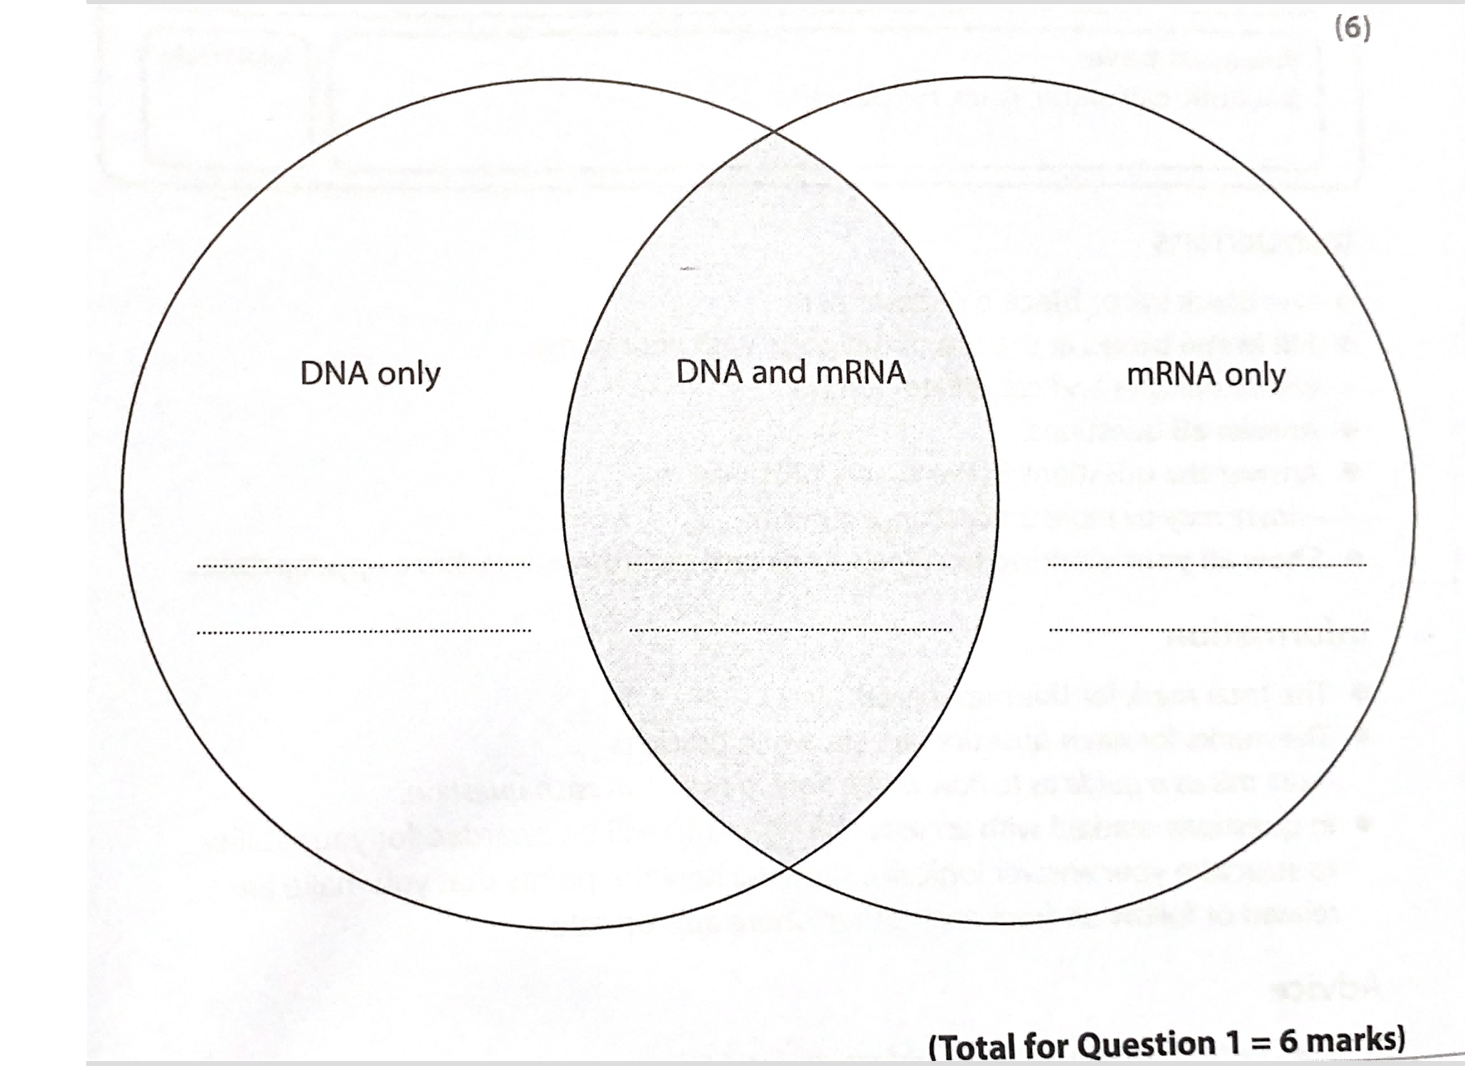
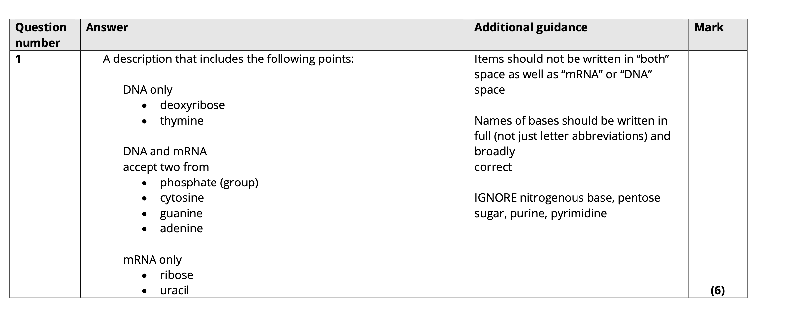
deoxyribose
phosphate group
uracil
thymine
cytosine
ribose

Slide 35
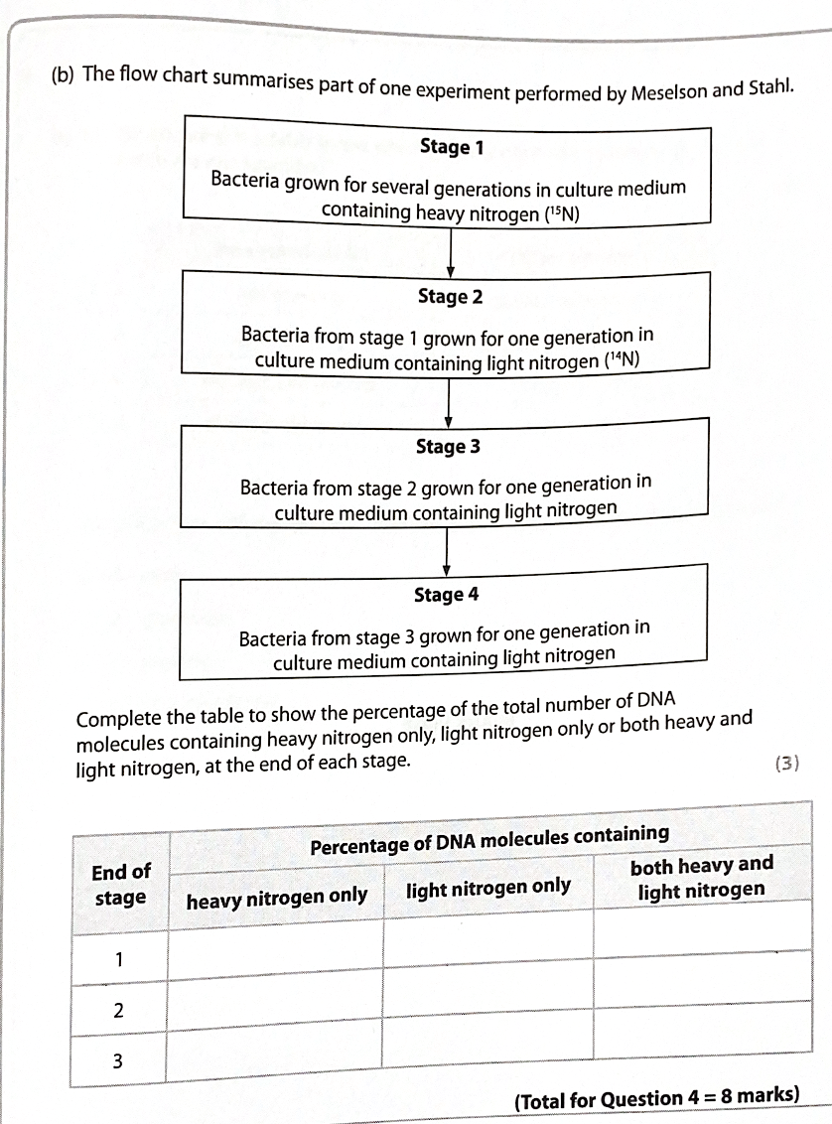
100
0
0
半保留复制
0
50
100
50
0
0

Slide 36
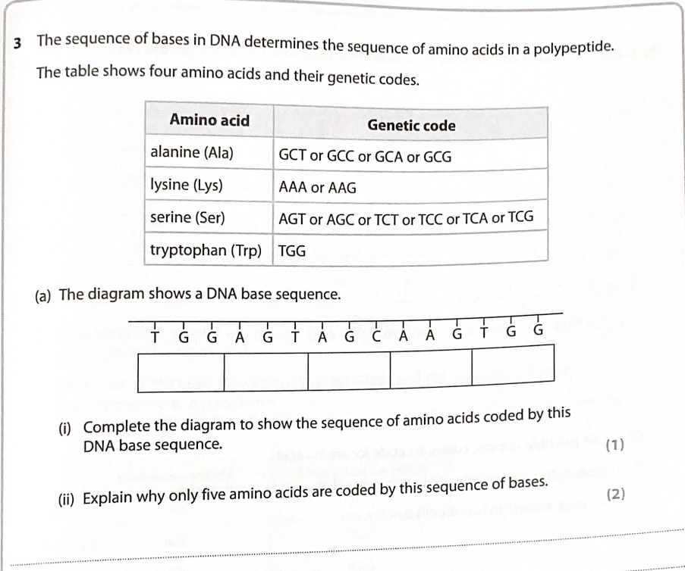
A C C T C A T C G T T C A C C
tryptophan serine serine lysine tryptophan
there are 3 triplet code,there is no stop codon

Slide 37
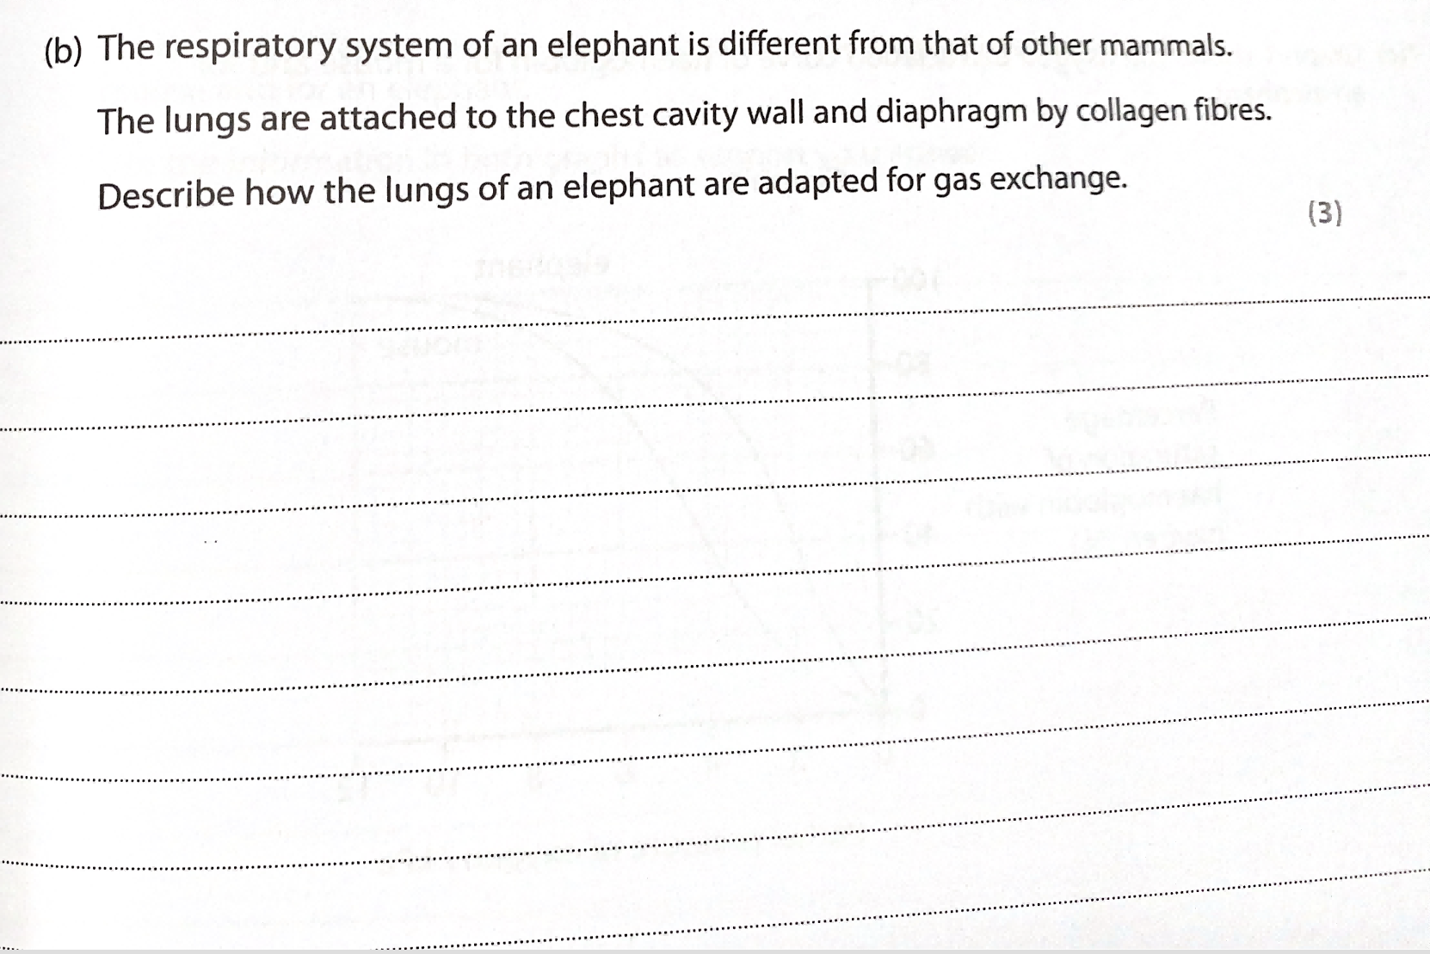
alveoli provides large surface area, greater diffusion rate
large capillary network
thin walls: short diffusion distance ,great diffusion rate

Slide 38
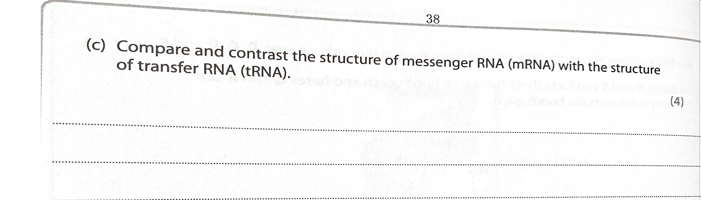
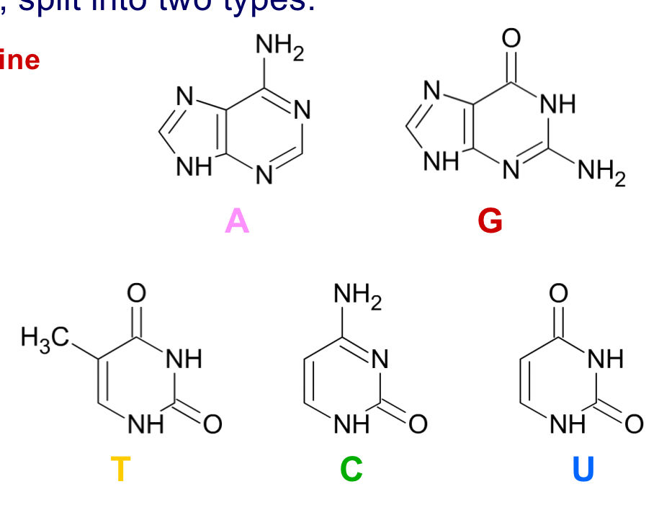
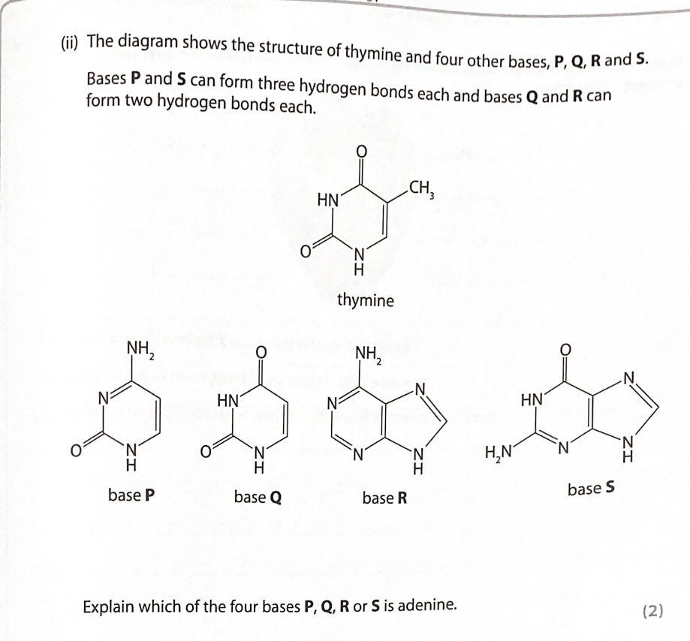
EXPERIMENTAL RESULS
相同点：both trna and mrna are single stranded(1’)
both cantain ribose（1’）
不同点：mrna is a straight chain while trna is folded(1’)
mrna has codons while trna has anticodon(1’)
R is adenine because it can form 2 hydrogen bonds.
R is adenine is double- ringed base.

Slide 39
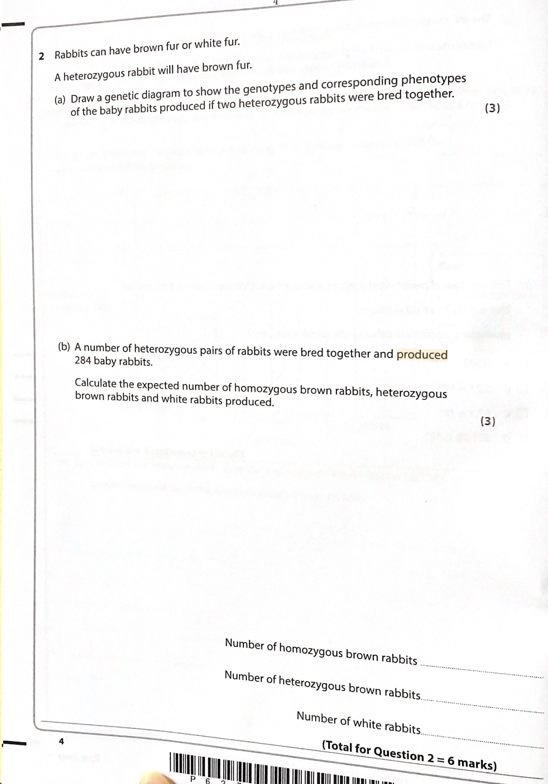
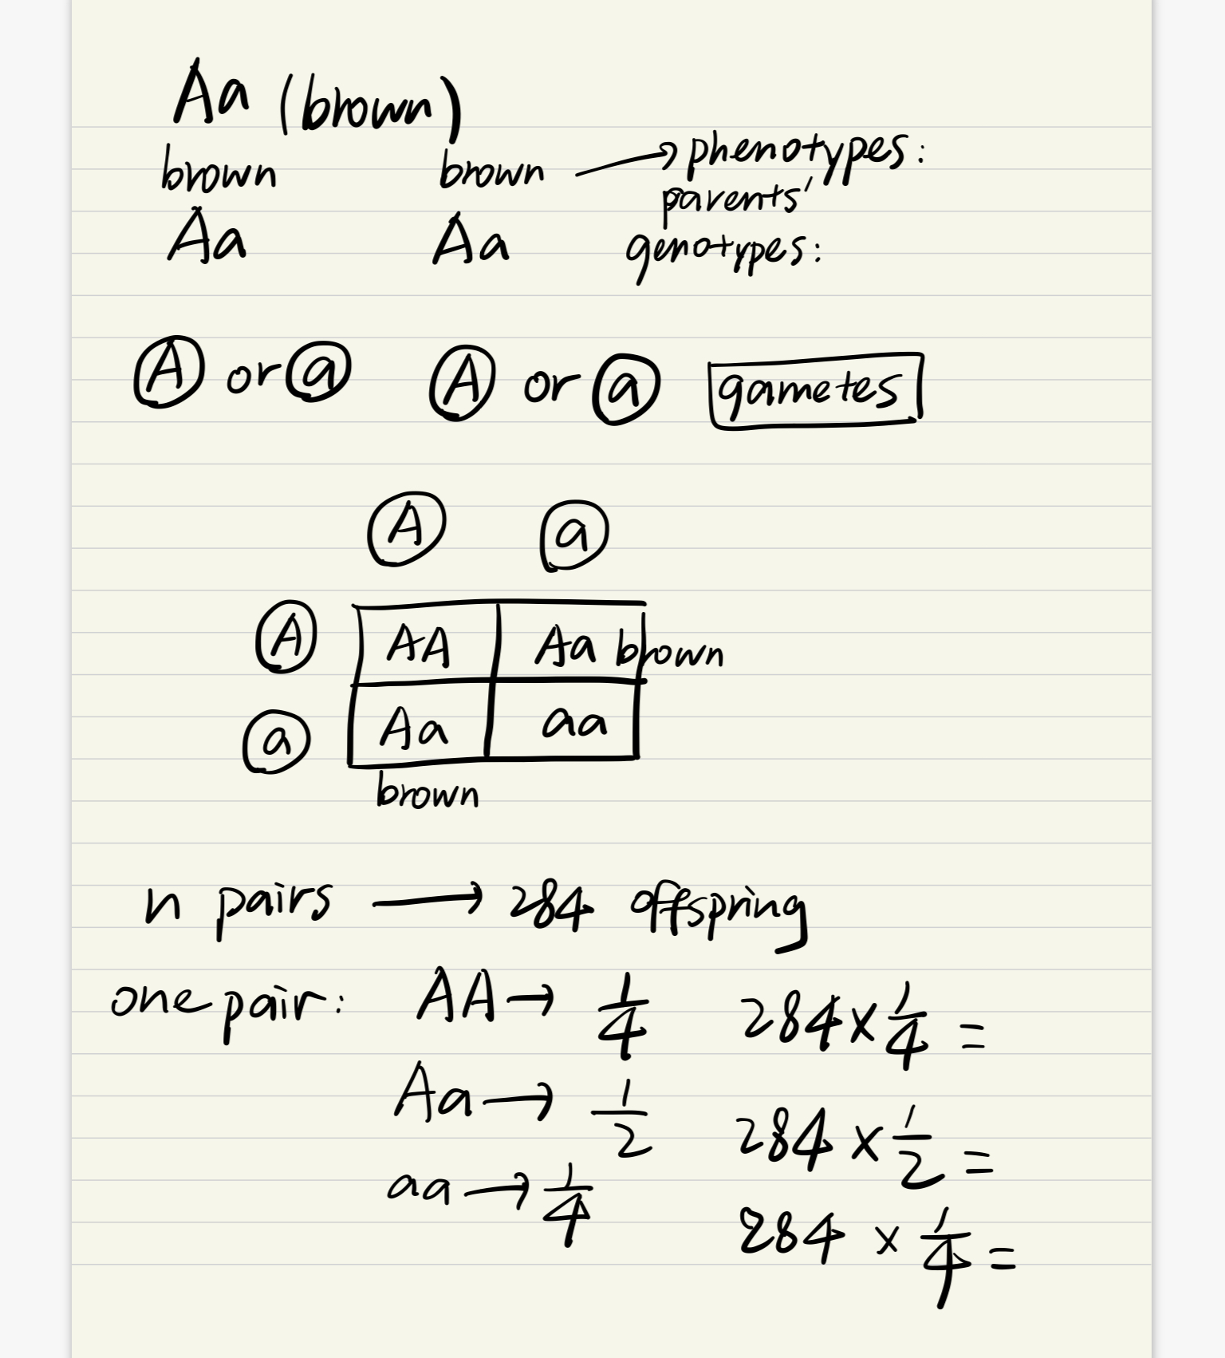
Aa
Mercury is the closest planet to the Sun and the smallest one in te Solar System—it’s only a bit larger than our Moon, The planet’s name has nothing to do with the liquid metal since，Mercury is the closest planet to the Sun

